Slide 1

Modeling Electricity Usage Profiles
Modeling hourly electricity usage profiles for residential customers

Slide 2
Background
Electricity usage data is increasingly becoming available due to smart meter technology implementations.
1
An customer’s hourly energy usage profile – a series of energy (kWh) as a function of time – is time‐series data that can reveal a lot about energy efficiency.
2
The prediction of accurate hourly electricity usage is of great economical interest
4
Grouping customer electricity accounts based on usage profiles allows for the comparison and contrasting of those with similar energy usage patterns.
3

Slide 3

Problem Statements
Identify patterns in residential customer electricity hourly usage and group customers based on similar usage profiles. Identify customers to target for energy efficiency programs
Current method to forecast a customer’s residential electricity usage is error-prone and could be more accurate. The goal is to predict individual residential electricity hourly usage day ahead more accurately than the current benchmark method.

Slide 4
Explore the hourly usage data
1
Aggregate by season and hour of the day
2
Group/cluster accounts by similar usage profile
3
Identify customers using excessive electricity during peak hours
4
Quantify effects of energy efficiency targeting for these customers
5

Slide 5

Data highlights
Retrieved from a data repository provided by Pecan Street, an organization focused providing access to data on consumer energy consumption behavior for research purposes.
Hourly residential electricity usage available from 2011 through 2017 for almost 1,000 customers
Demographic information available for each customer including housing square footage, annual income, education level, and number of occupants.

Slide 6
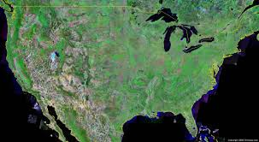
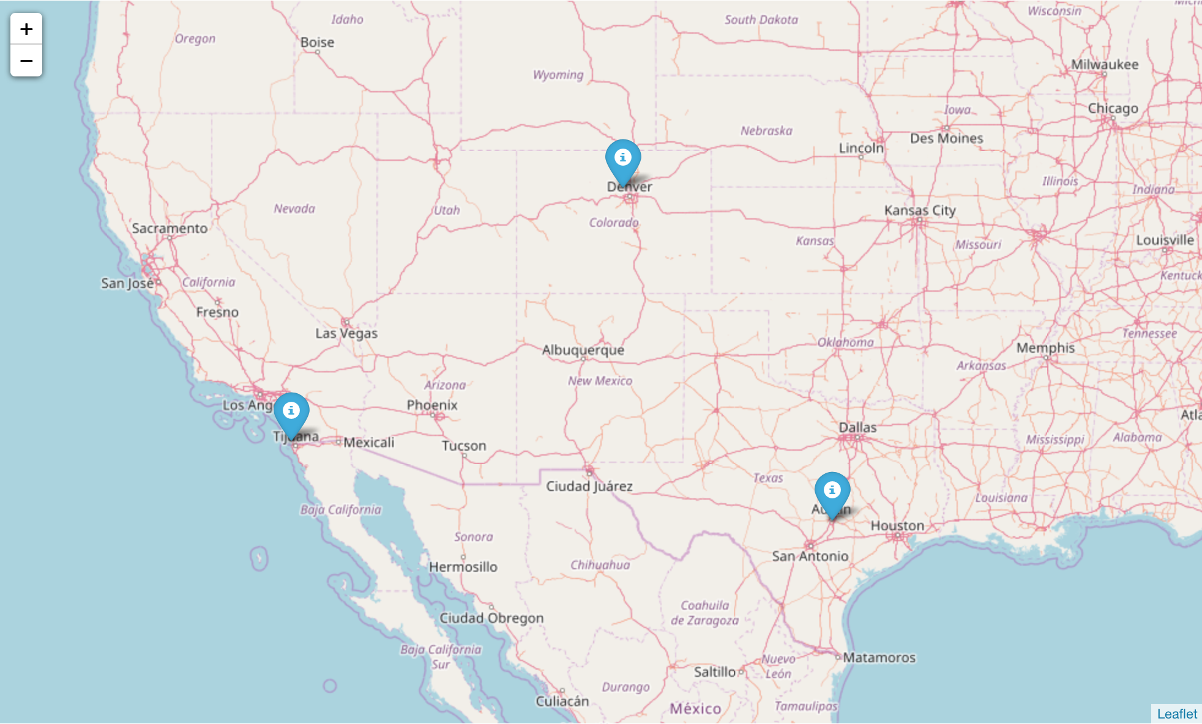
Data highlights
Pecan Street has access to hundreds of residential house/apartment electricity customers from Texas, Colorado, and California.
When the missing data covered several hours or less, simple linear interpolation using data before and after the interval sufficed.
However, if the interval is of considerable length (usage gap greater than 4 hours), the data is removed from the dataset.
Boulder, CO
58 customers
San Diego, CA
57 customers
Austin, TX
899 customers

Slide 7
Exploring the Data
Focused on electricity usage data for year 2015
373 customer accounts had complete set of usage available for 2015
Filled in gaps of usage using average of nearest available usage
Average customer yearly usage = 11,287 kWh
Average square footage = 2144 sq. ft.

Slide 8
mean of customer account usage by month of the week (2015)
The overall mean of all the customer account usages by month and day of the week for the year 2015.
On average, usage peaks in the early afternoon daily and tends to be much higher in the summer months.
This is expected considering majority of the customers are in the Austin, Texas area, where warm summer temperatures translates to increased air conditioning usage in the summer months.
Peak summer usage occurred between 4pm and 6pm daily
Winter
Spring
Summer
Fall

Slide 9
Clustering profiles using DATA SCience
Clustering can be used to measure the similarity between accounts and group them based on energy usage. The goal in clustering time‐series data is to organize the data into homogeneous groups, maximizing the similarity between groups.
Clustering is an ideal feature since the aim is to compare and contrast individual energy profiles, which can be accomplished with distinct distance measures providing a tangible dissimilarity measure.
Creates a mean profile, which is desired because mean profiles can be used in energy efficiency comparisons.

Slide 10
Goals for clustering usage profiles
Goal of clustering is to identify accounts that are similar and potentials for energy efficiency.
01
Clustering accounts based on these profiles allows for the comparison and contrasting of those with similar energy usage tendencies.
02
Accounts may be similar to each other in energy usage tendencies, but not in their usage throughout the day because of environmental/ behavioral differences.
03

Slide 11
Clustering energy usage profiles
For each customer’s 2015 usage data, aggregated usage by season and hour of the day
Divided hourly usage values by total annual usage in order to compare to usage profiles of that of other customers
Data science clustering uncovered 10 distinct usage profiles (numbered 0-9)

Slide 12
Clustering energy usage profiles

Slide 13

Energy cluster profile #0
Average 2015 summer hourly usage for cluster #0.
28 customer accounts in this cluster tended to have 9am-5pm Monday-Friday jobs (lower usage during this time) away from home with use of air conditioning due to warmer temperature climate
All located in Austin, Texas) (much higher usage in Summer compared to other seasons).
Larger houses, average square footage 2,500 sq. ft.

Slide 14
Energy cluster profile #6
Average 2015 summer hourly usage for cluster #6.
27 customer accounts in this cluster tended to more consistent usage between workdays and weekends.
Most households had children at home and houses were located in areas with more moderate climate in the summer (most were located in Boulder, Colorado).

Slide 15
Energy Cluster profile #7
Average 2015 summer hourly usage for cluster #7.
6 customer accounts had peak usage in the morning hours and appeared to be away during the daytime hours with low usage.
Majority were two adult person households and senior citizens.

Slide 16
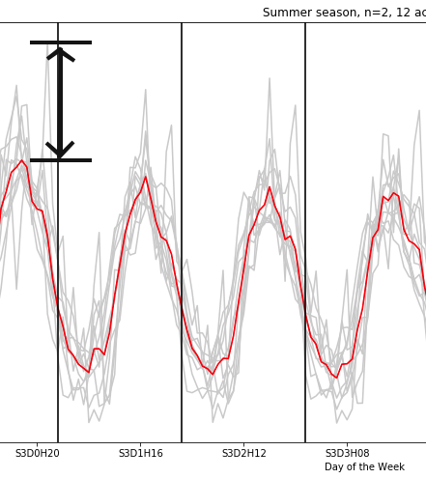
Targeting Customers with High Usage
Main focus on customers with high usage over and above summer peak usage
Resources with the lowest variable operating costs are always dispatched first, while more expensive generating units—like peaking power plants—are brought online when demand increases.
Customers exceeding average summer peak usage for their profile are targeted

Slide 17

Targeting Customers during peak demand
Resources with the lowest variable operating costs are always dispatched first, while more expensive generating units—like peaking power plants—are brought online when demand increases.
During system peak demand, real-time energy prices spike

Slide 18
Targeting Customers with High Usage
Customers exceeding average summer peak usage for their profile are targeted
Target these customers to reduce load by 50% during peak hours
Translates to 1.5% of total yearly usage for top customer

Slide 19
Targeting Customers with High Usage
Summer peak electricity price in Texas (2015) = $39.59/MWh ($25 avg.)
$329.19 total recovery for all 373 accounts
Customer ID | Usage Overage | $ Recovery for 50%
604 | 488.5 | 9.67
9935 | 414.5 | 8.21
3795 | 365.4 | 7.23
5262 | 341.4 | 6.76
7510 | 307.2 | 6.08
4313 | 290.5 | 5.75
5921 | 290.0 | 5.74
2072 | 283.7 | 5.61
1700 | 276.3 | 5.47
3719 | 256.3 | 5.07

Slide 20
Forecasting day-ahead electricity usage
Current baseline method to forecast a customer’s residential electricity usage is error-prone and could be more accurate. The goal is to predict individual residential electricity hourly usage day ahead better than the current benchmark method.
Real-time prices are consequently much more volatile than day-ahead prices due to their unpredictable nature.

Slide 21
Forecasting day-ahead electricity usage
Baseline Prediction Model
Historical averaging models are the simplest prediction methods used by utility providers
The next day’s prediction is calculated by taking hourly averages across the past ten immediate or similar days
Excludes weekends & holidays.
ARIMA Time-Series Prediction Model
A Time Series (TS) model predicts future values based on previous observations.
The commonly used Auto-Regressive Integrated Moving Average (ARIMA)
Includes a specific number of past observations in the model and takes account the moving average of the usage.

Slide 22
Baseline prediction for april 2015 data
Current baseline prediction calculated by:
Taking hourly averages across three most recent past days with highest average consumption value out of a pool of ten previous days

Slide 23
ARIMA MODEL PREDICTION FOR APRIL 2015 DATA
The Auto-Regressive Integrated Moving Average (ARIMA) [24] is a time series model that takes into account the the past observations to make future predictions.
Able to better capture the peak and dips in customer usage compared to baseline prediction

Slide 24
MODEL PREDICTION COMPARISON for APRIL 1, 2015 DATA
ARIMA Model Prediction for 4/1/2015
Baseline Prediction for 4/1/2015
31.2% reduction in forecasting prediction error over baseline

Slide 25

Results
Problem 1: Clustering by electricity usage profile
Data science techniques can allow for the grouping of presidential customer's hourly usage into usage profiles based on similar hourly and seasonal usage trends can result in the ability to target customer accounts for energy efficiency programs.
Customers with usage over and above those accounts with the same usage profile during peak hours where targeted to reduce usage.
With successful reduction of 50% of usage at peak summer hours, with average real-time price of $39.59 during summer peaks.
Total dollar recovery targeting all 373 customers is $329.19
Problem 2: Forecasting day-ahead hourly electricity usage
31.2% reduction in forecasting prediction error using ARIMA model over baseline
Real-time prices are consequently much more volatile than day-ahead prices due to their unpredictable nature so accurately day-ahead predictions are valuable in avoiding unnecessary price volatility

Slide 26
Future directions
Future directions involve investigating future models to furthur improve forecasting projections.
1
Increasing the number of accounts available for investigation to furthur cluster accounts having more detailed difference.
2
Use demographic/behavioral information of household to predict future residential usage for new customers.
3

